Slide 1
Test Reservation System
Justin Oglesby
Patrick Hightower
Troy Rosenburg Tristan Capron
© 2011, Team Booboo (FSU Computer Science, Spring 2011Software Engineering II)
Notes:
Provide background on our team, our project, what the function of the system is and why we’re bringing it to them.

Slide 2
Current System
CGI script based
Primary storage system is file-based
Reliability issues
No way to check whether a student is enrolled in a class or not
No secure log in
Very basic interface
Limited to, at most, two classes with no more than three tests per class
Notes:
These are the basic things about the current system that Dr. Gaitros uses. These are mostly things that he does not like about the system that he wants changed.

Slide 3
Requirements
Provide an intuitive, familiar and reliable method for students to register to take an exam at the University Testing Center
Allow students to review, modify or remove their previously made reservations
Allow for scheduling of next semester without interfering with current semester
Require unique, secure Log In information for both students and administrators to validate user identity
Notes:
These requirements were the things that Dr. Gaitros approached us with at the beginning of the semester. They are mostly functional requirements that specify the exact working parameters of the system. Not all requirements are included here.

Slide 4
Requirements Cont’d
Allow for students to be in an unlimited number of classes, and be registered for an unlimited number of tests
Allow for a class to have an unlimited number of tests associated with that class
Provide a method to automatically upload the class rosters from BlackBoard
Provide a log file that will keep records of modifications to reservations
Provide methods for creation of test schedules, both on a weekly basis and an individual basis.

Slide 5
Test Reservation System
PHP script based
Primary storage file system is MySQL Database
Reliable and protected storage
Checks for when a student is enrolled in a class and has tests available to make reservations for
Secure log in
UI face-lift
Unlimited number of classes, locations, tests and test sessions available.
Notes:
These are the improvements offered by our system over the current existing system. It’s important to note that the people we are presenting to DO NOT use the current system. Most of this is just background so that they understand what the system does, why we’re upgrading it and why we’re bringing it to them to see if they would be interested

Slide 6
Architecture
Current server set up:
Linux Server (Arch Linux)
MySQL 5.1.47
PHP 5.3.2.6
Apache 2.2.15
However, should be compatible with any recent versions of MySQL, PHP, and Apache.
Notes:
Pretty self explanatory, mostly software stuff that’s required to run the server

Slide 7
Compatibility
HTML Front End
Complies with HTML 4.01 Transitional standards
Templated for consistent look between pages
Student side utilizes minimal Javascript to maximize compatibility
Administrator side will make use of Javascript to facilitate easy creation of test schedules
Minimalist interface ensures even the lower end net-books and mobile devices will be able to use the system without difficulty or frustration
Notes:
One of our design points. Compatibility was always at the forefront of our design to ensure that anyone would be able to use it.

Slide 8
Compatibility
Tested on the following Operating Systems/Browsers for compatibility:
Windows XP
Internet Explorer
Firefox
Chrome
Windows 7
Internet Explorer
Firefox
Chrome
OSX 10
Firefox
Chrome
Safari
iOS
Safari
Android 2.1
Blackberry
Other mobile phones
Compatibility varies based on phone-specific browser, works on all tested phones

Slide 9
Key Features
Ability to expand
Virtually unlimited number of classes, tests, sessions, and students available
Front-end completely separated from the data access; no need to rewrite the entire system for integration with another data access system
Can be used as a stand-alone tool for teachers who wish to coordinate with the University Testing Center, or directly by the Testing Center Staff to plan out test schedules
Notes:
Expandibility is the key to why we’re bringing it to them. We feel that this could be used as a tool to augment their current method of scheduling test sessions, for use by teachers, or by the actual testing center staff.

Slide 10
Key Features
Ease of use
Designed to feel very familiar to anyone who has used any of the BlackBoard secure apps
Simple, intuitive interface that will allow for students to use it without any prior training or knowledge
On screen help will be provided for anything that may be unclear
Provide all information necessary to ensure a smooth test session reservation process for both the Testing Center and the students.
Notes:
Ease of use is kind of a big deal when dealing with computer literacy students..

Slide 11
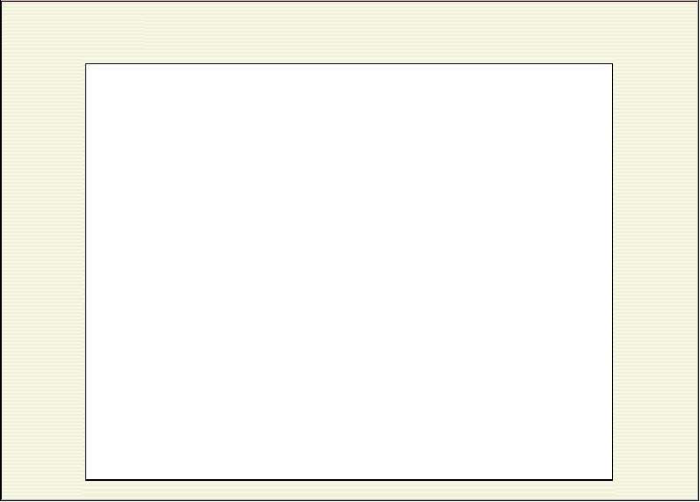
Key Features
Compatibility
As small, lightweight net-books become more common on campus, it is important to consider how much screen “real estate” is being used
With mobile phones and devices becoming an even faster growing trend than net-books, it is important to adhere to the W3C HTML standards to ensure compatibility with all devices
Minimal use of graphics means fast load times and very small use of bandwidth
Largest image in the system is 44 bytes

Slide 12
Demo Information
Current development site:
http://troyprog.dyndns.tv/~testres/testres.php
May have a test version deployed to CS webserv after Spring Break
Admin Username and Password
Username: testingcenter
Password: staff
Student Username and Password
Username: teststudent
Password: student
Notes:
After I give a talk about these slides, we’ll be moving into a live, working demonstration of our system. I’ve provided this information so that at any point after the demonstration they can go back and play with the system themselves to determine whether it will be useful to them or not as a tool as well as provide feedback to us so that we can make improvements.

